Slide 1
Real State System
-Java and Data Structures
D2Real

Slide 2
This system is for …
    To keep track of a company’s residential listings
    Add house details using system
    To view details of houses
    To perform searching and sorting
    & remove house records from system
Improvements …
    increase productivity
    reduce time spent on administration
    replace all manual task

Slide 3
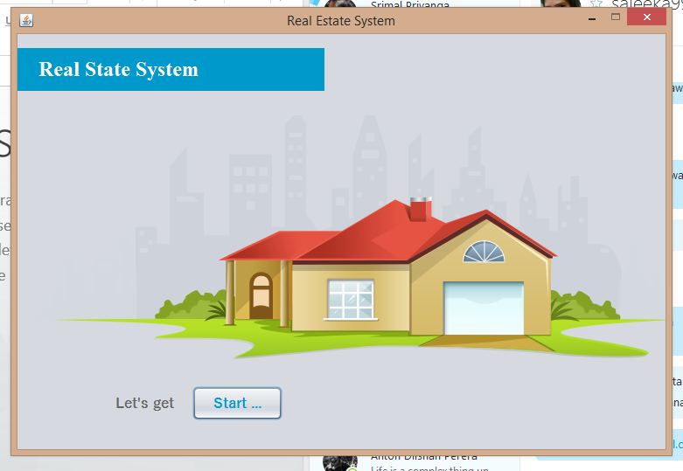
Architecture …
~/. based on MVC architecture
~/. user Friendly designing
~/. focus on high User Experience
~/. +Clean & Simple look & feel
Download :
https://github.com/UCDGeeks

Slide 4
How it Happened ..?
    Java as main programming language
    1 Main class to handle whole functionality on program
    2 Modals to handle all data
    3 Main java controller classes
    4 Views for user interactions
    Have used Git as a VCS

Slide 5
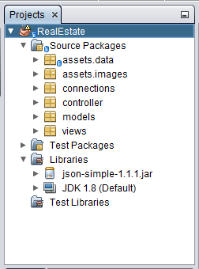
Have a
look..

Slide 6
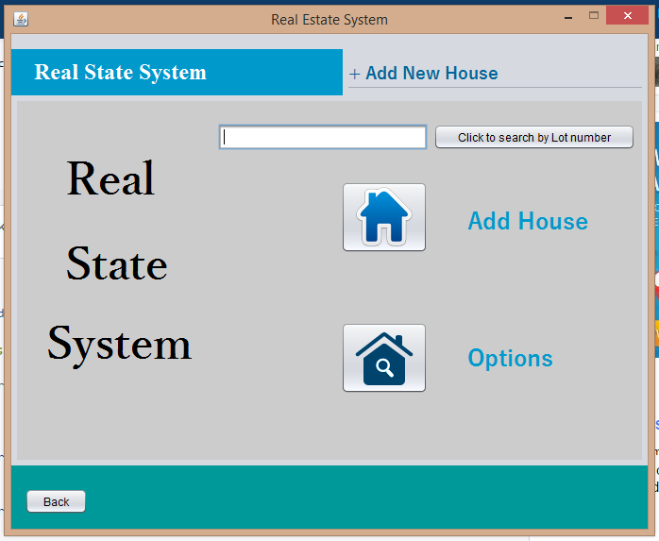
When it works..

Slide 7
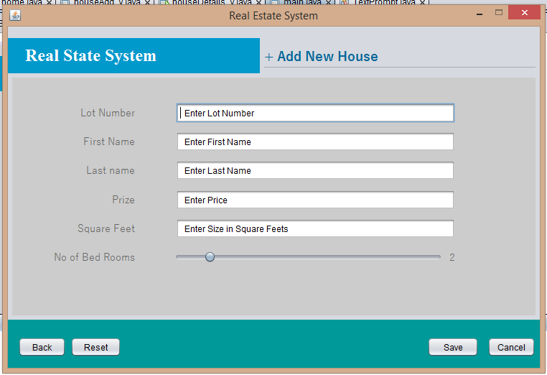
Add a house…

Slide 8
Search house by Lot
Number…

Slide 9
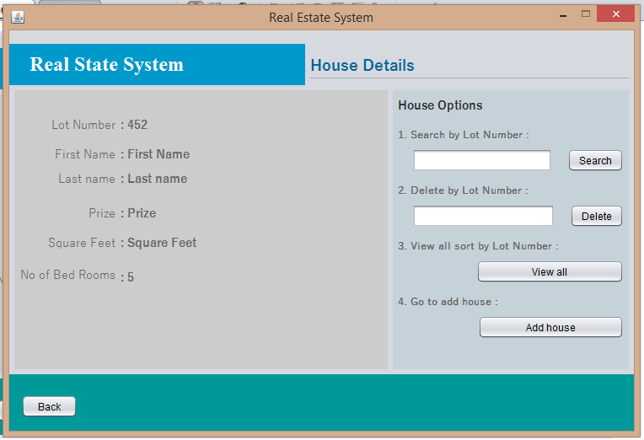
View house details…

Slide 10
Delete house by Lot
Number…

Slide 11
Options …
~/. Search by Lot Number
~/. Delete by Lot Number
~/. Go to add house
~/. + View all Sort by Lot Number

Slide 12
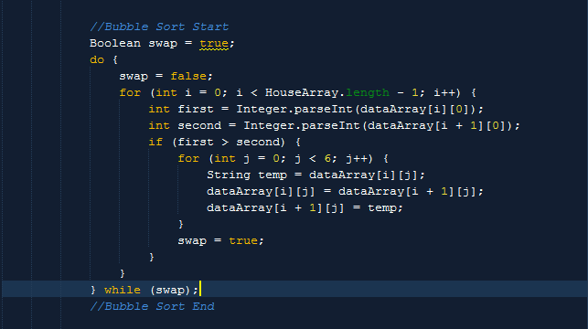
Where DSA...?

Slide 13
How we use DSA...?
    Bubble Sort as a sorting algorithm
        it’s fast
        & really good when use for small arrays
    Arrays & list to store data
    Linear search as searching algorithm
        - Perfect for unsorted arrays
        - Because system use small arrays

Slide 14
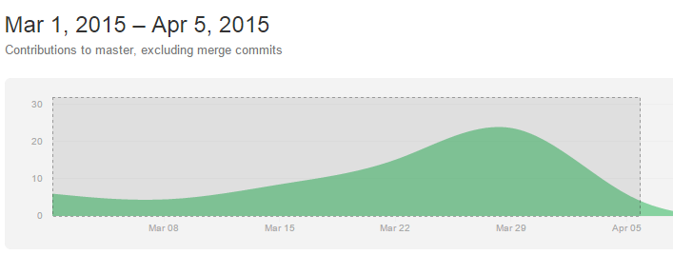
Team Work & Timeline
~/. Srimal 14208910
~/. Anton 14209006
~/. Thisaru 14209028
~/. Sajeeka 14209028
~/. Kalana 14208883
Host :
https://github.com/UCDGeeks/RealEstate_System

Slide 15
Thank You !
D2Real

